Slide 1
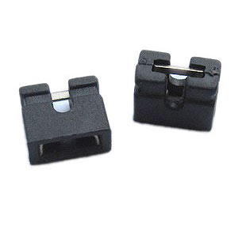
What is a jumper?
A jumper is a type of permanent switch. It creates a bridge between two electronic pins. This bridge closes the circuit.
To open the circuit you need to remove the jumper.
You can replace a jumper with a single wire.

Slide 2
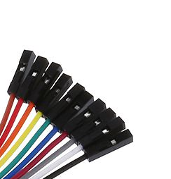
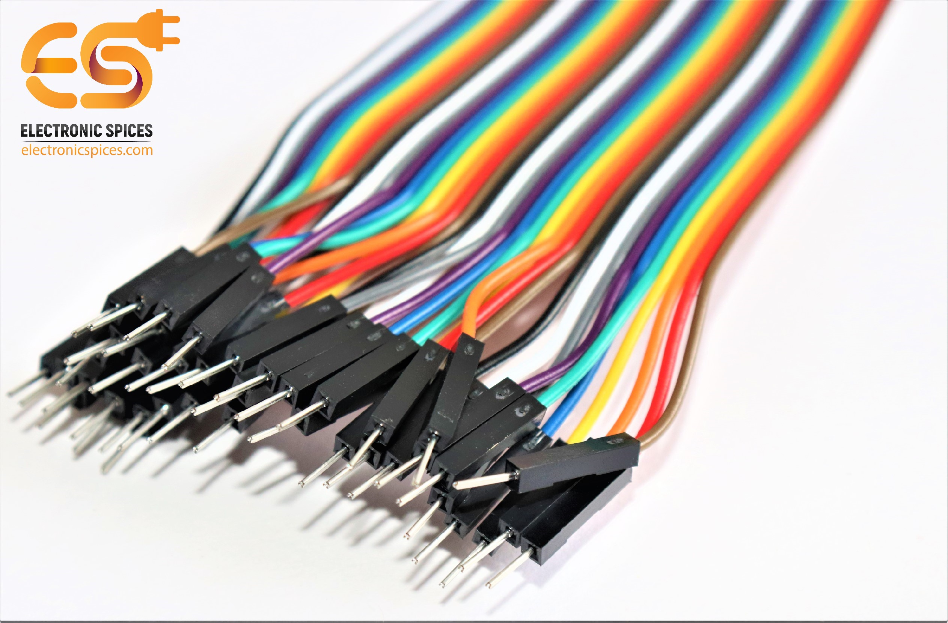
pin connector names
female connectors
male connectors

Slide 3
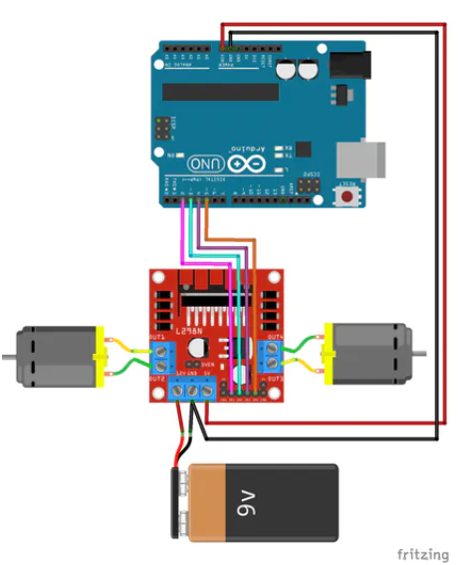
L298 Wiring
This shows how the L298 should be wired up.
Ensure the ground two ground wires are connected to each other before connecting to the GND terminal.
We connected pins:
2 -> IN1
3 -> IN2
4 -> IN3
5 -> IN4
V_{in} -> +5V
GND -> GND
The voltage regulator should be enabled!

Slide 4

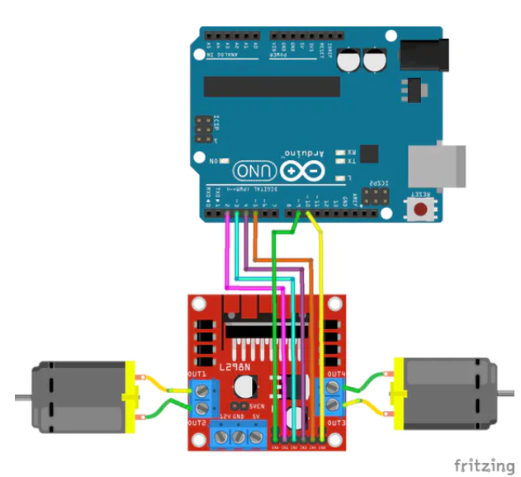
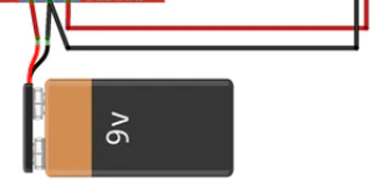
Speed control connections
We connected the PWM pins to ENA and ENB.
We chose pins
9 -> ENA
10 -> ENB
You need to remove the jumpers from ENA and ENB, but don’t lose them.

Slide 5
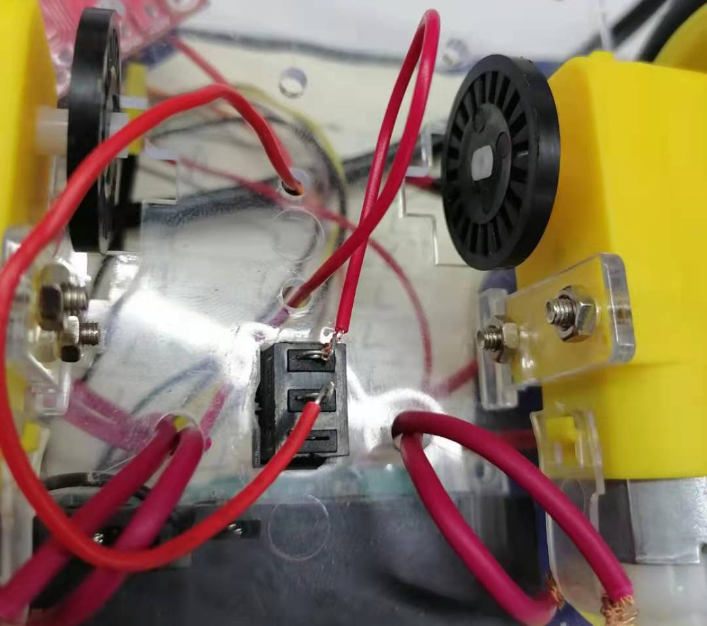
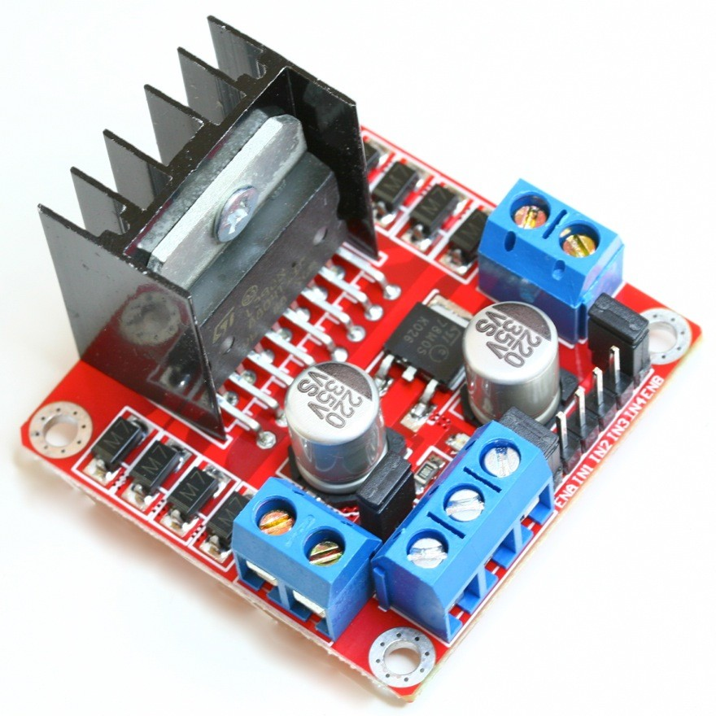
We added a simple power switch
One terminal of the switch connects to the red wire from the battery pack. The other terminal is connected to the Voltage in of the L298 motor board.
+
-

Slide 6
We used some code like this…
We used some code like this to control the speed of our motors. We are able to set the speed and direction of each motor.

Slide 7
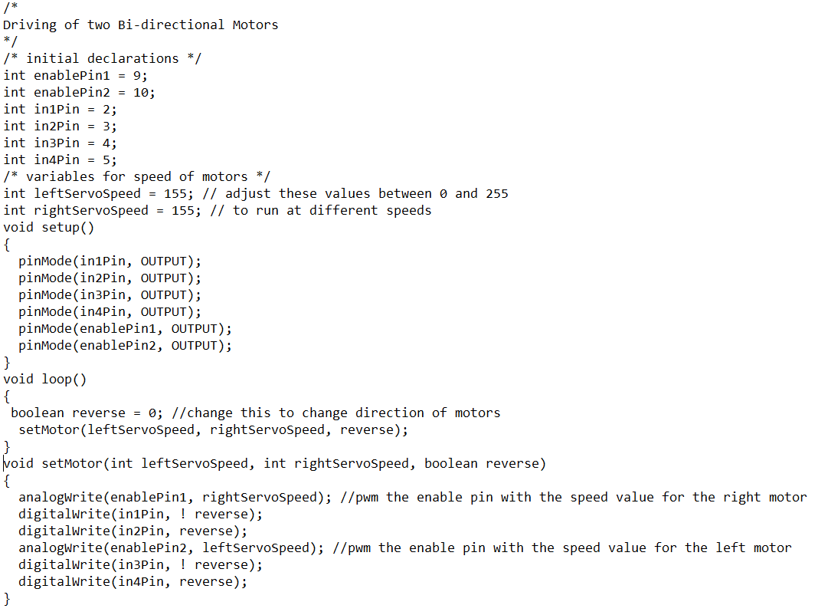

Slide 8
Now, our robot should be finished
The car should be able to move forwards and backwards at any speed we choose.

Slide 9
First, we need to check our robot
You may notice that your car gradually turns to one side when the car is moving forwards or backwards.
This is because there is a small difference between the speeds of the motors.
This is due to two reasons:
One motor may be getting less power than another due to a bad connection.
Components are not identical. There are minor differences in how they perform. We need to understand this and account for it.

Slide 10
Second, we need to categorise our robot
If our robot turns left, we need to reduce the speed of the right motor a little. We can fine-tune the speeds of the motors until our robot runs in a straight line at its best speed.
We can then measure this performance by timing how long it takes to travel a set distance. We have chosen to use 10 floor squares, which is around 6m. We can use the clock feature on our phones to time this distance. We can run the experiment 3 times and average the results to get a speed in meters per second.
Then we can try using different speeds.
What speed is needed for the robot to start. How fast is that?
We can create a table of results, and even plot a graph.

Slide 11
example table
Motor speed | Time 1 | Time 2 | Time 3 | Average speed
0
255

Slide 12
Taking it further
So far, we have completed the basics. We have built our robot and categorised it. This is all very useful, but we can use our imagination to change things even more.

Slide 13
We know that we can control our robot speed with 6 pins
Pin 9 -> ENA
Pin 2 -> IN1
Pin 3 -> IN2
Pin 4 -> IN3
Pin 5 -> IN4
Pin 10 -> ENB
But is there a way to use less pins? Our Arduino only has 14 digital pins. When we add sensors, LEDs and more, we can quickly run out of pins.

Slide 14
Can we control our robot speed with only 5 pins?

Slide 15
Yes, we can
We can do it, but we lose flexibility. We have to connect one of our Arduino pins to two inputs instead of 1.
We have different options, what are their effects?
ENA and ENB H) ENA and IN3
IN1 and IN3 I) ENA and IN4
IN2 and IN4 J) ENB and IN1
IN1 and IN2 H) ENB and IN2
IN3 and IN4 H) ENB and IN3
ENA and IN1 H) ENB and IN4
ENA and IN2

Slide 16
Can we control our robot speed with only 4 pins? or 3 pins? Or even 2 or 1 pin.

Slide 17
By using less pins we lose flexibility
It becomes impossible to independently control the speed and motor direction of each wheel.
Or does it?
Or does it?

Slide 18
Last class we used the following code to test the motors
void setup()
{
pinMode(in1Pin, OUTPUT);
pinMode(in2Pin, OUTPUT);
pinMode(in3Pin, OUTPUT);
pinMode(in4Pin, OUTPUT);
}
void loop()
{
setMotor(); // subroutine to control motor
delay(2000);
reverse = ! reverse;
}
void setMotor()
{
digitalWrite(in1Pin, ! reverse);
digitalWrite(in2Pin, reverse);
digitalWrite(in3Pin, ! reverse);
digitalWrite(in4Pin, reverse);
}
int in1Pin = 2;
int in2Pin = 3;
int in3Pin = 4;
int in4Pin = 5;
bool reverse = false;

Slide 19
Can we use this to vary the speed?
We know that we can use PWM to control the speed of a DC motor using an L293D chip or L298 board.
But this uses 3 Arduino pins. IN1, IN2 and EN1.
Can we control the speed of a DC motor using 2 Arduino pins, or even just 1?

Slide 20
Yes, we can.
Our IN1 and IN2 pins can be used to control the speed. Look at this table for the logic of IN1 and IN2. By leaving one input at LOW and switching the other to HIGH or LOW we can control the speed. We can simulate PWM.
Arduino PWM actually pulses at around 500Hz, and as the value is between 0-255, every pulse lasts around 2 milliseconds.
IN1 | IN2 | DC Motor
LOW | LOW | OFF
LOW | HIGH | REVERSE
HIGH | LOW | FORWARD
HIGH | HIGH | OFF

Slide 21
How can we use this?
Any ideas?
So, one approach we can use is to turn a motor on for a duration of time, then turn it off.
For example, if we want 50% speed we can turn the motor on for 5ms, then turn it off for 5ms.

Slide 22
void setup() {
pinMode(in1Pin, OUTPUT);
pinMode(in2Pin, OUTPUT);
pinMode(in3Pin, OUTPUT);
pinMode(in4Pin, OUTPUT);
}
void loop() {
setMotor(in1Pin, in2Pin, motor1Speed);
setMotor(in3Pin, in4Pin, motor2Speed);
}
void setMotor(int motorPin1, int motorPin2, int speed){
digitalWrite(motorPin1, HIGH);
digitalWrite(motorPin2, LOW);
delay(speed);
digitalWrite(motorPin1, LOW);
digitalWrite(motorPin2, LOW);
delay(10 - speed);
}
int in1Pin = 2;
int in2Pin = 3;
int in3Pin = 4;
int in4Pin = 5;
int motor1Speed = 5;
int motor2Speed = 5;
// 0 -> 10 denotes low to high speedeed
Can you see the flaws with this system?
Let’s look at the logic in detail.

Slide 23
If we set motor1Speed = 5, and motor2Speed=5, we get some logic like this
setMotor(in1Pin, in2Pin, motor1Speed);
set in1 = high, set in2 = low, delay(5)
set in1 = low, set in2 = low, delay(10-5)
setMotor(in3Pin, in4Pin, motor2Speed);
set in3 = high, set in4 = low, delay(5)
set in3 = low, set in4 = low, delay(10-5)
TIME | in1 | in2 | in3 | in4
1 | HIGH | LOW | LOW | LOW
2 | HIGH | LOW | LOW | LOW
3 | HIGH | LOW | LOW | LOW
4 | HIGH | LOW | LOW | LOW
5 | HIGH | LOW | LOW | LOW
6 | LOW | LOW | LOW | LOW
7 | LOW | LOW | LOW | LOW
8 | LOW | LOW | LOW | LOW
9 | LOW | LOW | LOW | LOW
10 | LOW | LOW | LOW | LOW
TIME | in1 | in2 | in3 | in4
11 | LOW | LOW | HIGH | LOW
12 | LOW | LOW | HIGH | LOW
13 | LOW | LOW | HIGH | LOW
14 | LOW | LOW | HIGH | LOW
15 | LOW | LOW | HIGH | LOW
16 | LOW | LOW | LOW | LOW
17 | LOW | LOW | LOW | LOW
18 | LOW | LOW | LOW | LOW
19 | LOW | LOW | LOW | LOW
20 | LOW | LOW | LOW | LOW

Slide 24
Delay, delay, delay
Each call to setMotor causes a delay of 10ms. So each motor will be turned off for 10ms. Even if we set them to the maximum speed (10), they will still spend half of their time turned off.
We can try to do some complicated logic with the setMotor function, by making it look at the two motors and their speeds, but that will get very complicated and messy. It becomes almost impossible to debug.
It is much better to keep things simple, and to remove the delay to somewhere else. This is where the concept of motorTimers comes in.

Slide 25
We are not talking about an actual clock. We can use a general delay of 1ms, check if we need to do any work, then loop again.
void loop() {
do work
delay(1);
}
We can use a simple variable to count, then do some work when it is the correct time.

Slide 26
We can make a motorTimer variable for the motor, this will count the current clock cycle. We can use it to determine if we need to do any work this clock cycle.
We need a variable to hold the maximum speed of the motor, just a simple integer is enough.
When our timer is less than the desired speed, we turn the motor on.
When the timer is greater than the speed, we turn the motor off.
When the timer reaches our limit (maximum speed), we reset it to 0.

Slide 27
If we set speed = 5, and maxMotorSpeed = 10, we get some logic like this:
motorTimer | Logic | in1 | in2 | in3 | in4
0 | motorTimer < speed (so turn motor on) | HIGH | LOW | HIGH | LOW
1 | motorTimer < speed (so turn motor on) | HIGH | LOW | HIGH | LOW
2 | motorTimer < speed (so turn motor on) | HIGH | LOW | HIGH | LOW
3 | motorTimer < speed (so turn motor on) | HIGH | LOW | HIGH | LOW
4 | motorTimer < speed (so turn motor on) | HIGH | LOW | HIGH | LOW
5 | motorTimer = speed (so turn motor off) | LOW | LOW | LOW | LOW
6 | motorTimer > speed (so turn motor off) | LOW | LOW | LOW | LOW
7 | motorTimer > speed (so turn motor off) | LOW | LOW | LOW | LOW
8 | motorTimer > speed (so turn motor off) | LOW | LOW | LOW | LOW
9 | motorTimer > speed (so turn motor off) | LOW | LOW | LOW | LOW
10 | motorTimer >= maxMotorSpeed (set motorTimer=0)

Slide 28
void setup() {
pinMode(in1Pin, OUTPUT);
pinMode(in2Pin, OUTPUT);
pinMode(in3Pin, OUTPUT);
pinMode(in4Pin, OUTPUT);
}
void loop() {
if (motorTimer >= maxMotorSpeed) {
motorTimer = 0;
}
setMotor(in1Pin, in2Pin, motor1Speed);
setMotor(in3Pin, in4Pin, motor2Speed);
delay(2);
motorTimer++;
}
void setMotor(int motorPin1, int motorPin2, int speed){
if (motorTimer < speed) {
digitalWrite(motorPin1, HIGH);
digitalWrite(motorPin2, LOW);
} else {
digitalWrite(motorPin1, LOW);
digitalWrite(motorPin2, LOW);
}
}
int in1Pin = 2;
int in2Pin = 3;
int in3Pin = 4;
int in4Pin = 5;
int motor1Speed = 0;
int motor2Speed = 0;
int maxMotorSpeed = 10;
int motorTimer = 0;

